Slide 1
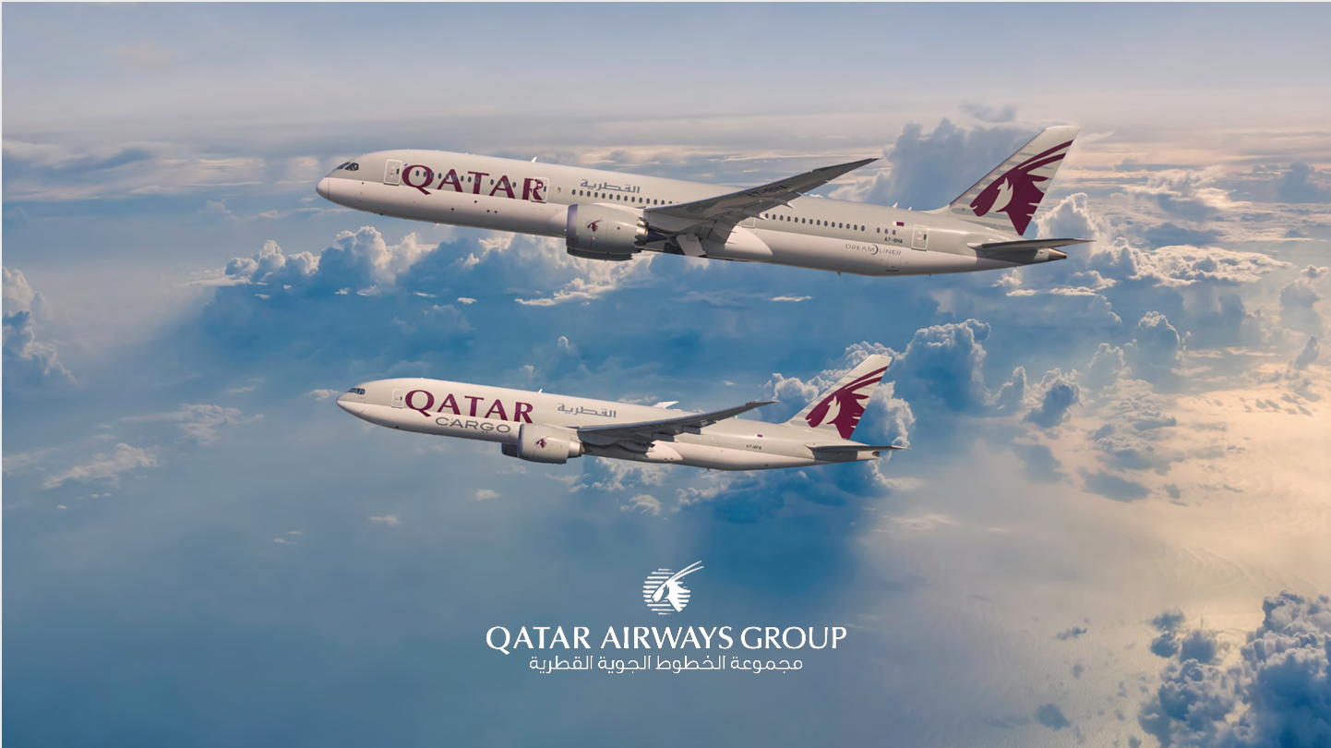

Slide 2

Qatar AirWays In-flight Enterainment System

Slide 3
TABLE OF CONTENTS
01
03
PROJECT OBJECTIVES
RESULTS ANALYSIS
02
04
METHODOLOGY
CONCLUSIONS
Project background and brief from client (Qatar Airways)
Recommender system application & business value.
Market analysis & research of various recommender systems
Recommendations and Suggestions

Slide 4
01
PROJECT OBJECTIVES

Slide 5
PROJECT OBJECTIVES
Sytem
Competence
Opportunties
Construct a recommendation platform based on content or collaborative filtering.
Accurately predict user rating of movie not yet viewd based on historical preferences.
Sytem’s ability to increase passengers traveling with Qatar Airways.

Slide 6
02
METHODOLOGY

Slide 7

World’s Best Inflight Entertainment 2021
Delta Air Lines
Qatar Airways
Emirates
Singapore Airlines
We are here
04
01
03
Our Goal
02

Slide 8

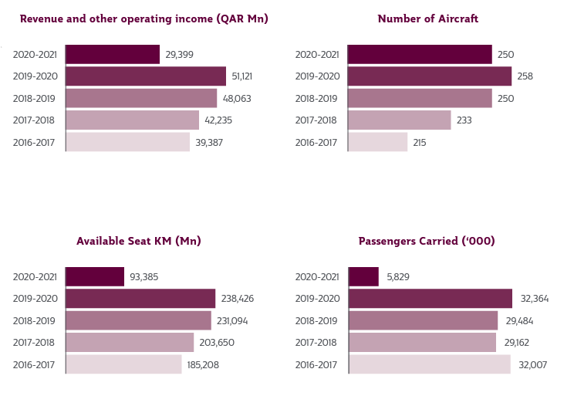

Slide 9
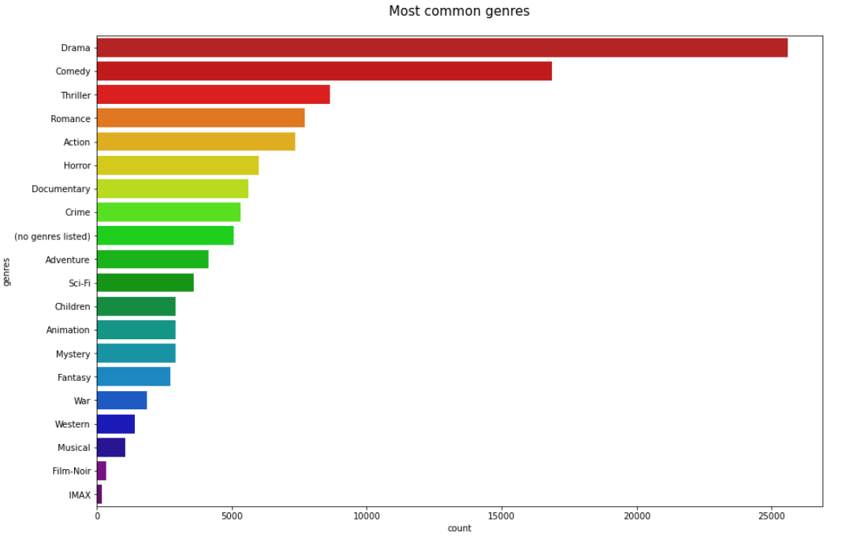

Slide 10
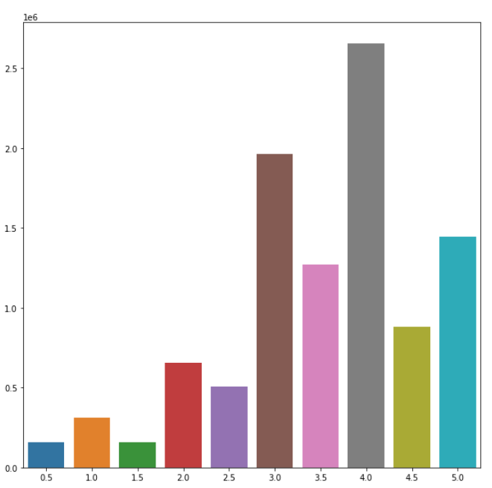

Slide 11
03
RESULTS ANALYSIS

Slide 12

Content-based Filter

Slide 13



Slide 14
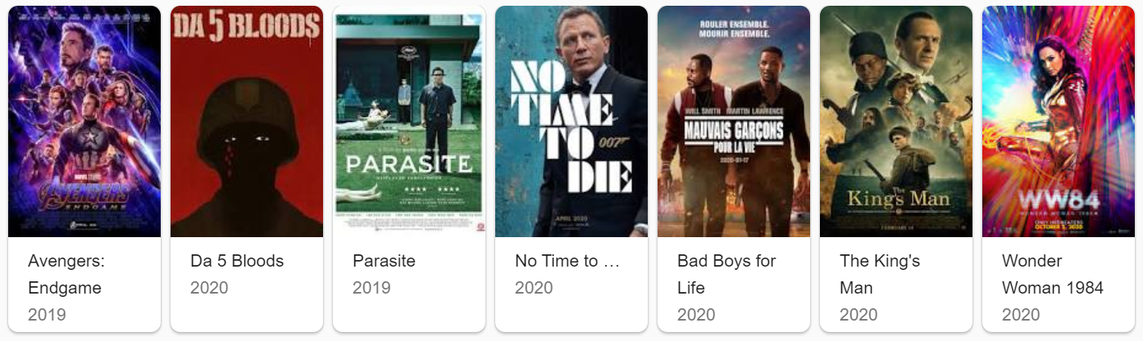
RECOMMENDER SYSTEM DEMO

Slide 15
CONCLUSIONS
01
02
System
Economic

Slide 16

THANKS!

